Slide 1

Container-Tracking & Umweltdatenerfassung
Luca A. Gekle, Maximilian S. Kampl, Marko D. Schrempf
24. Februar 2025
DI (FH) Günther Hutter, MSc. DI Dr. Georg Judmaier
HTL Leoben
Notes:
Mündlich überliefert:
Motivation der Themenwahl
Erläuterung der Problemstellung
Erläuterung des Lösungsansatzes

Slide 2
Problem
a total of 250 million containers are transported worldwide every year [1]
2500 containers are damaged [2]
1566 are lost [1]
25% are temperature-controlled [3]
we want to enable customers to react to special conditions through continuous monitoring

Slide 3
Goals
tracking of containers during overseas transport
GPS tracking
collection of environmental data for a specific container
temperature
humidity/pressure
vibration
provision of historical environmental data per container
development of hardware prototypes for a proof of concept
modern user interface for querying and visualizing the recorded data

Slide 4
Partner/Conceptual formulation
HTL Leoben
container tracking
building prototypes
determine positioning
read out environmental data
persist data
display data in web application
Notes:
Mündlich überliefert:
Motivation der Themenwahl
Erläuterung der Problemstellung
Erläuterung des Lösungsansatzes

Slide 5










SDGs
Notes:
3.
8
9
12
14

Slide 6

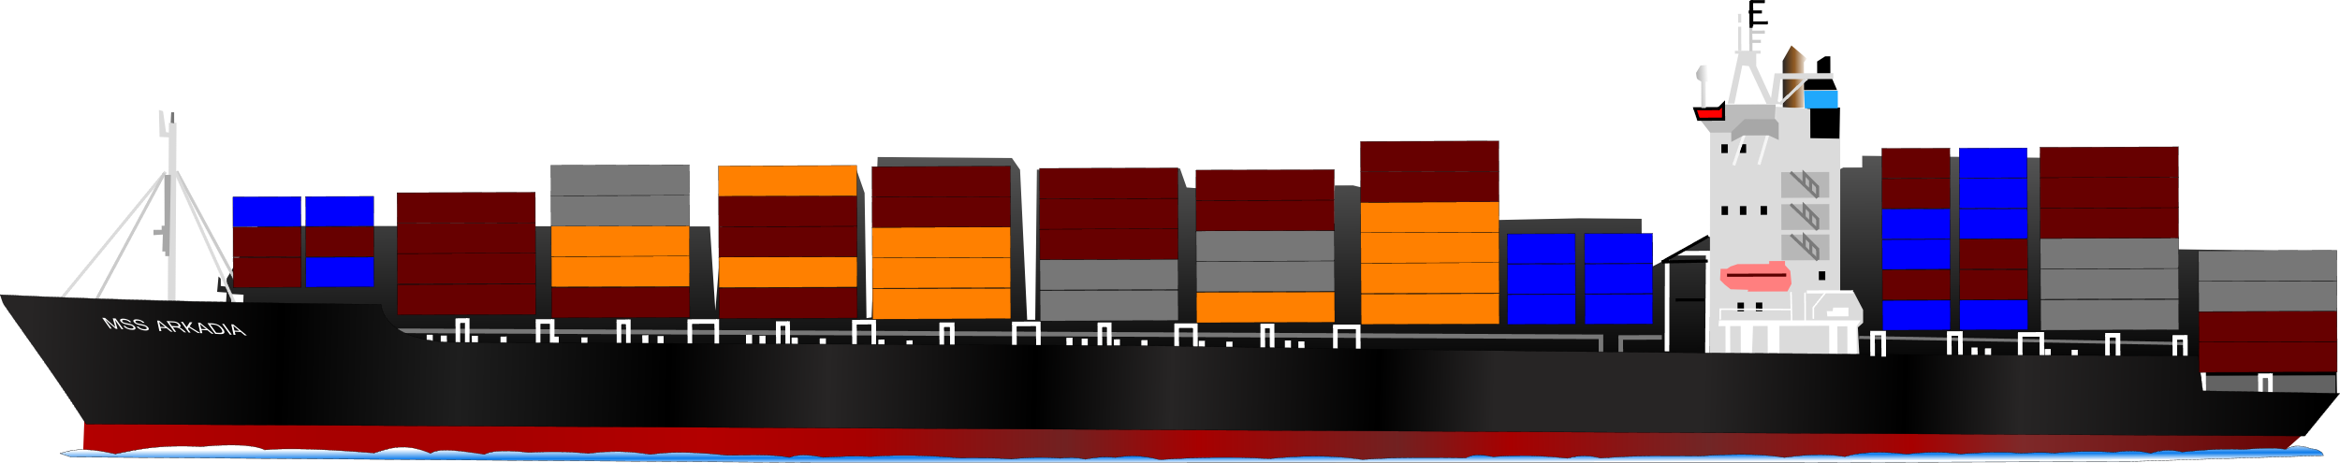
Allocation of tasks

Slide 7

Luca Alexander Gekle
Webanwendung
Graphentheorie
Simulator
Luca A. Gekle

Slide 8
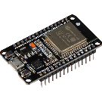
Hardware
Sensorik
Datenübertragung
Maximilian S. Kampl

Slide 9
Hardware
Sensorik
Datenübertragung
Maximilian S. Kampl

Slide 10
Hardware
Sensorik
Datenübertragung
Maximilian S. Kampl

Slide 11

REST
Server
Datenbanken
Marko D. Schrempf

Slide 12
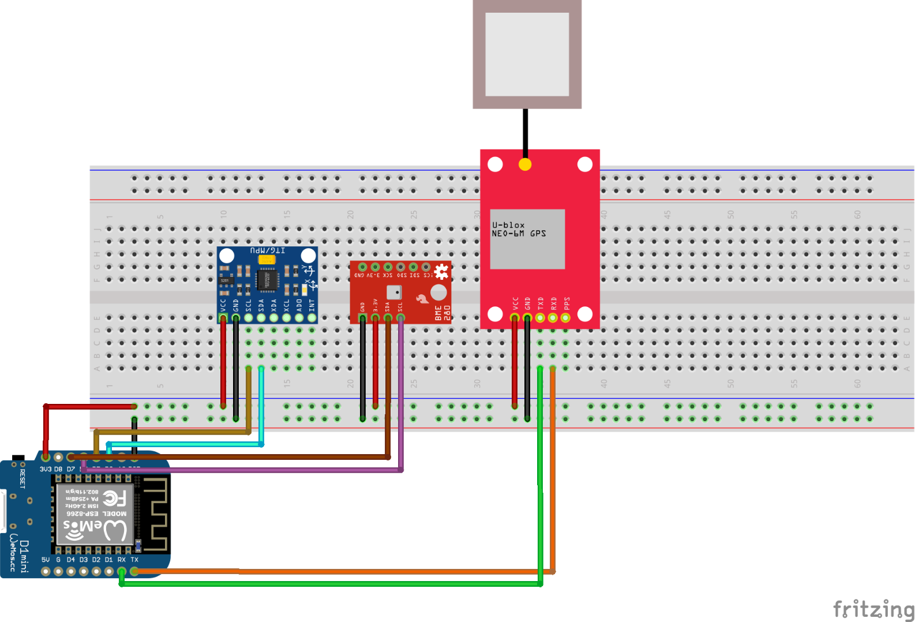
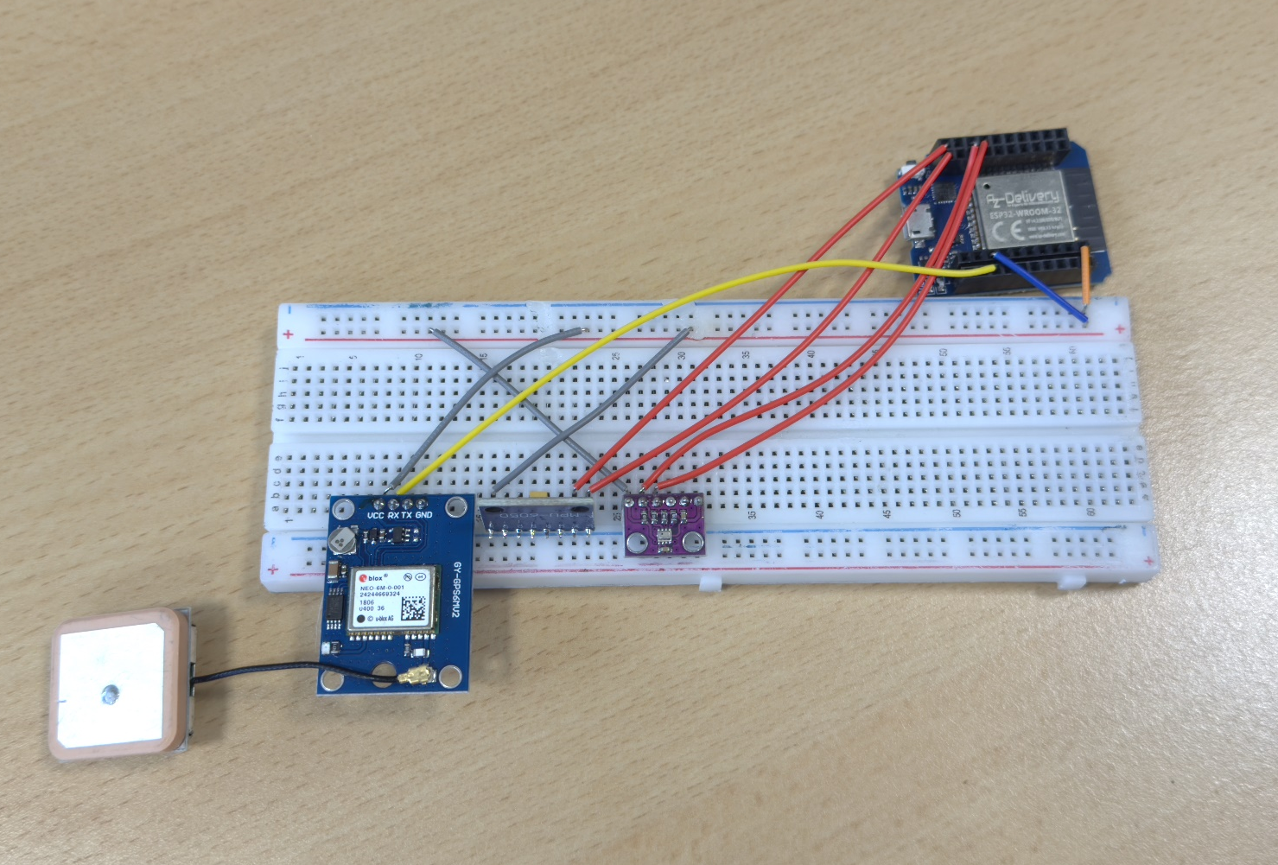
Progress - Kampl
hardware research
Soldering
data acquisition/transmission
ArduinoIDE --> PlatformIO
mesh network

Slide 13
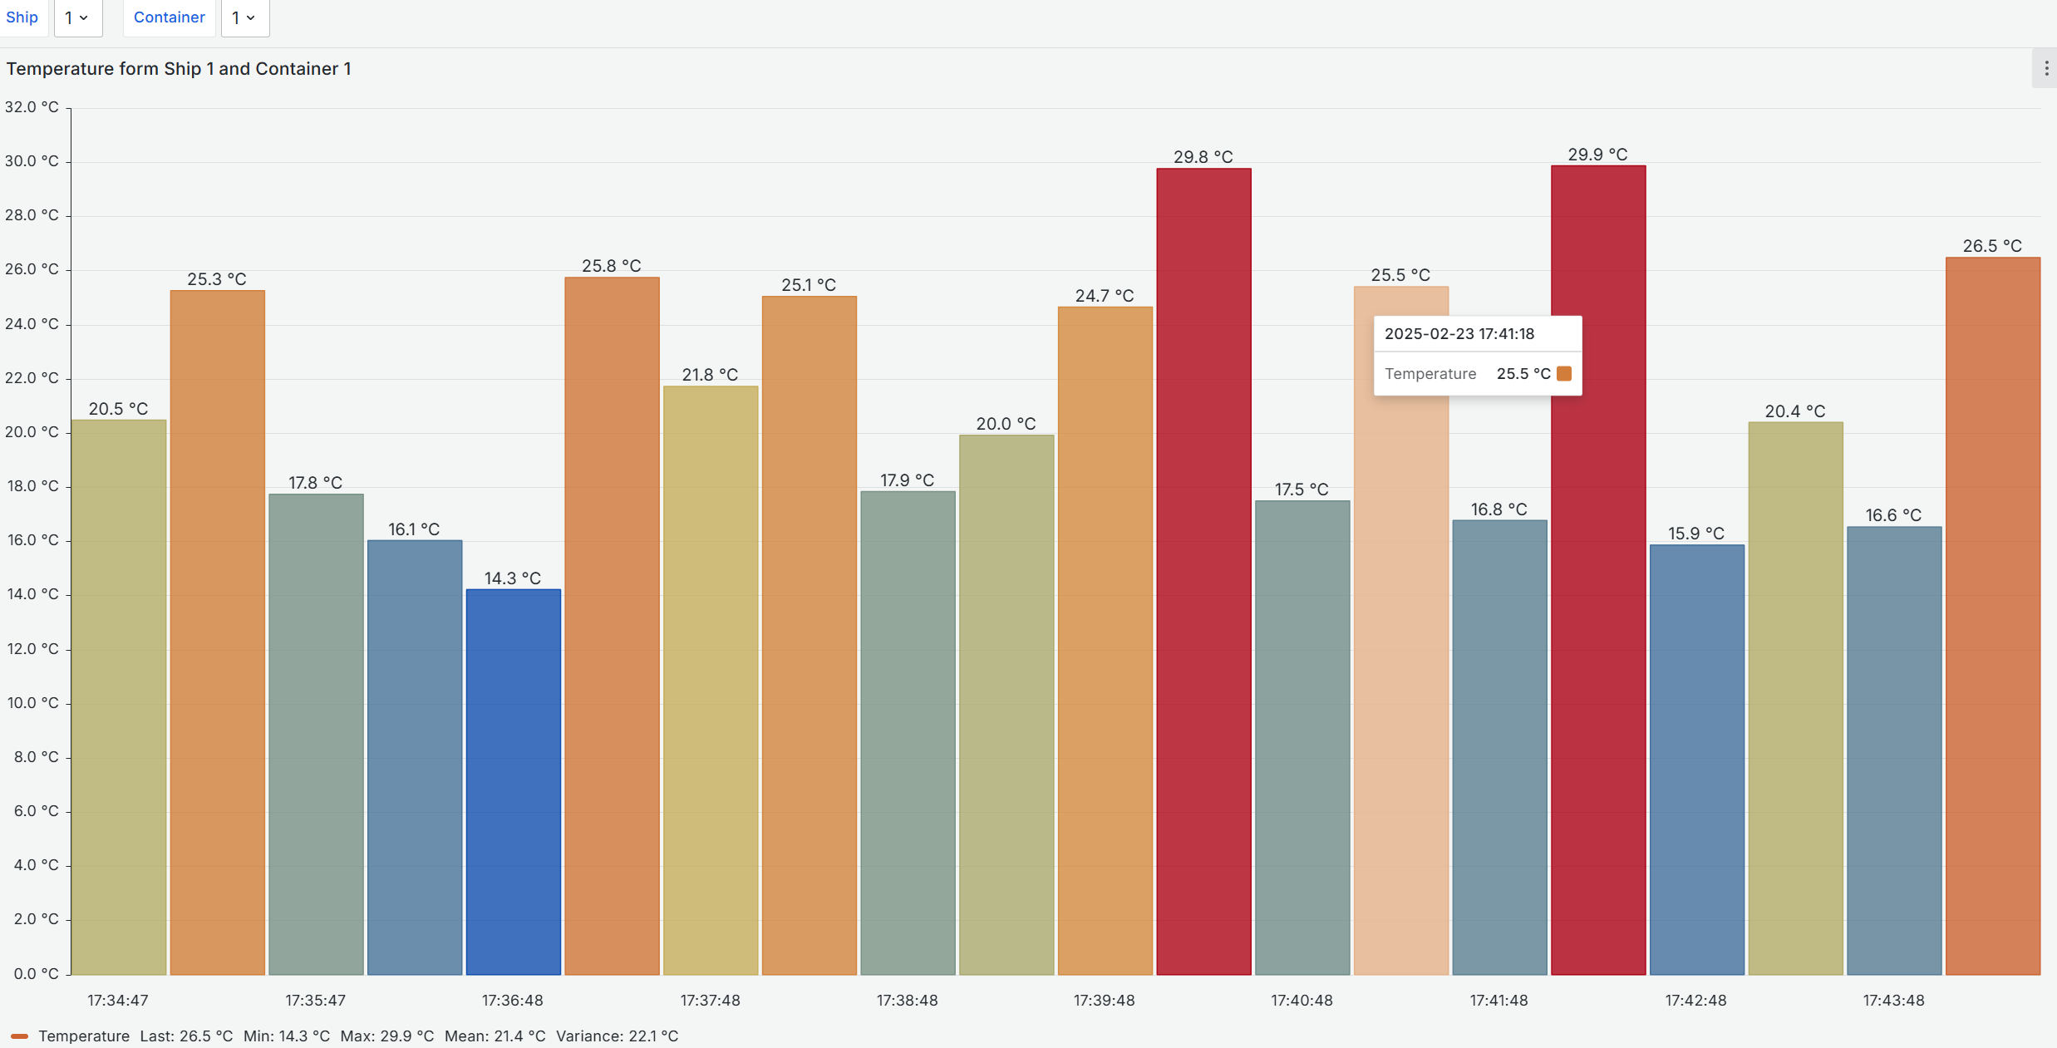
Progress - Schrempf
Databases
REST interface
authentication
data visualization

Slide 14
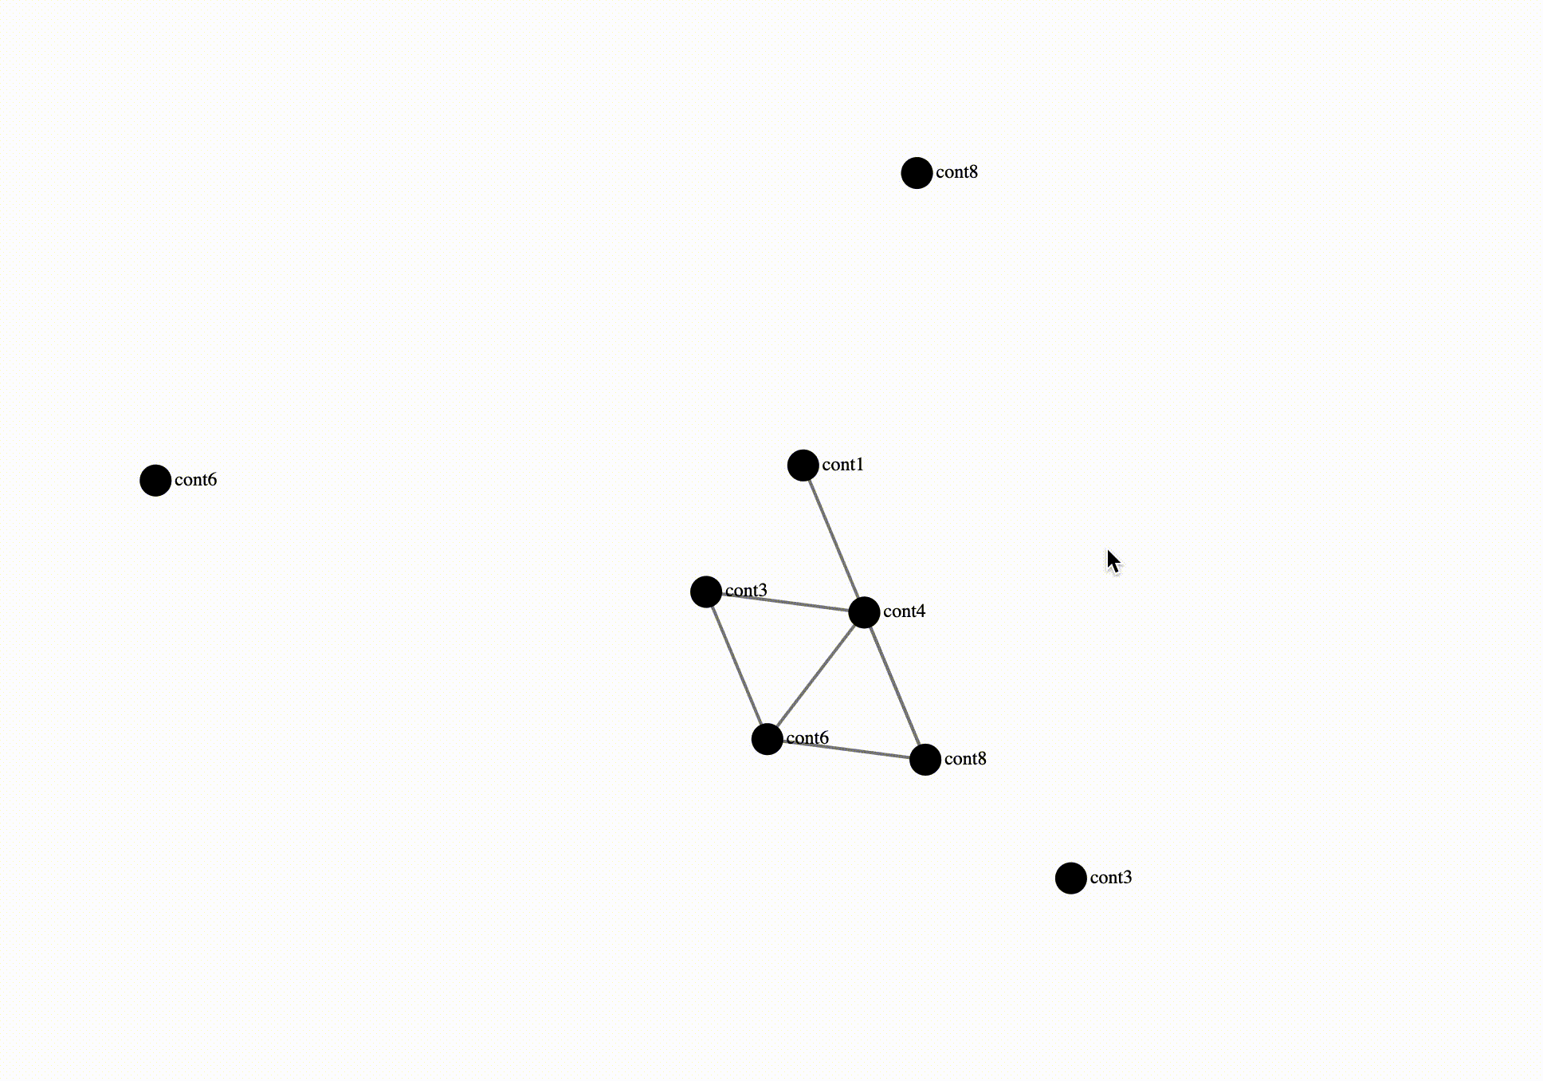
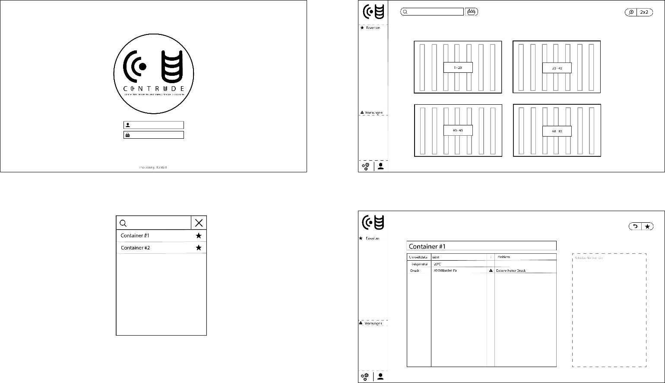
Progress - Gekle
website layout
simulation
directed-draggable-graph
positioning algorithm
first website design
Notes:
NICHT LÖSCHEN!!!!!
NICHT LÖSCHEN!!!!!
NICHT LÖSCHEN!!!!!
NICHT LÖSCHEN!!!!!
NICHT LÖSCHEN!!!!!
NICHT LÖSCHEN!!!!!
NICHT LÖSCHEN!!!!!
NICHT LÖSCHEN!!!!!
NICHT LÖSCHEN!!!!!

Slide 15
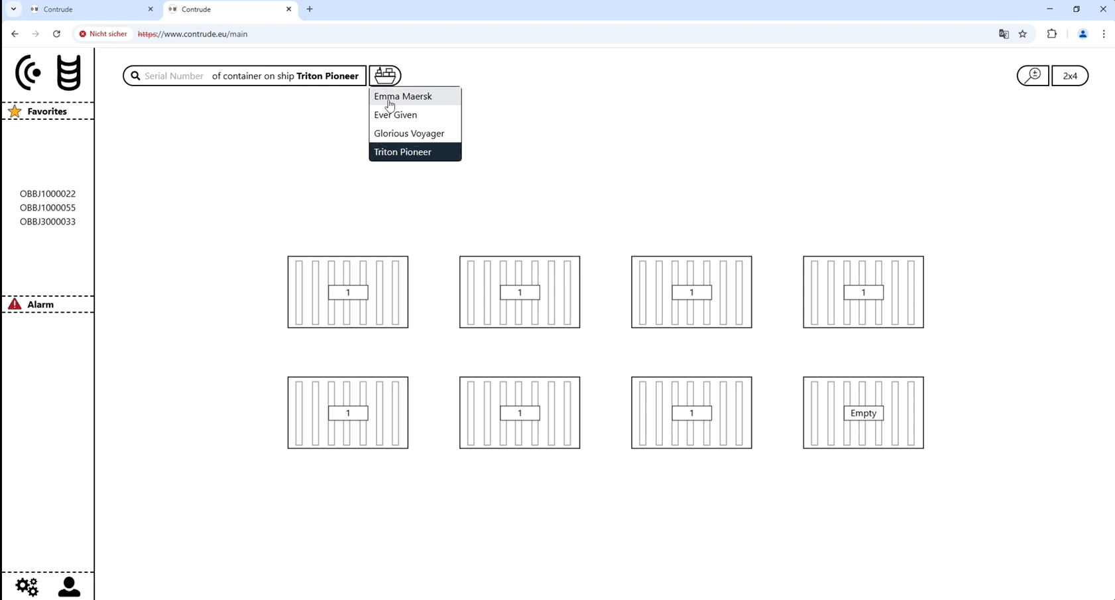
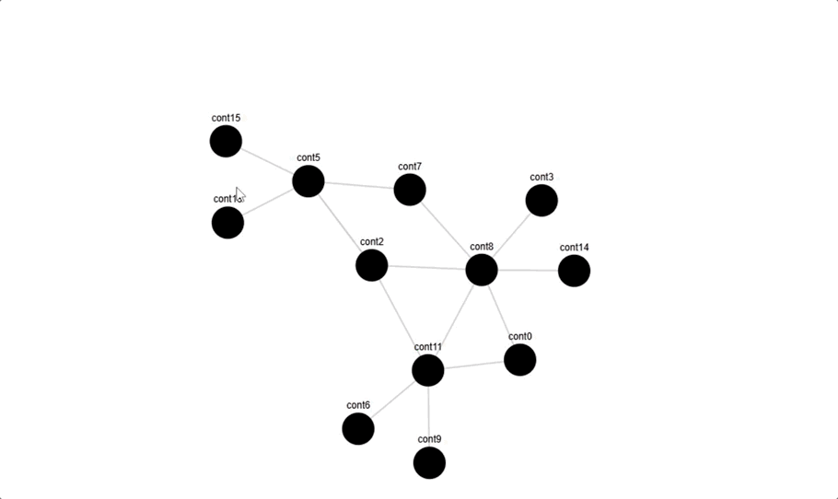
Progress - Gekle
website
login-Page
main-Page
detail-Page
link website with backend
dragable graph (DG)
color
code for creating the JSON files

Slide 16
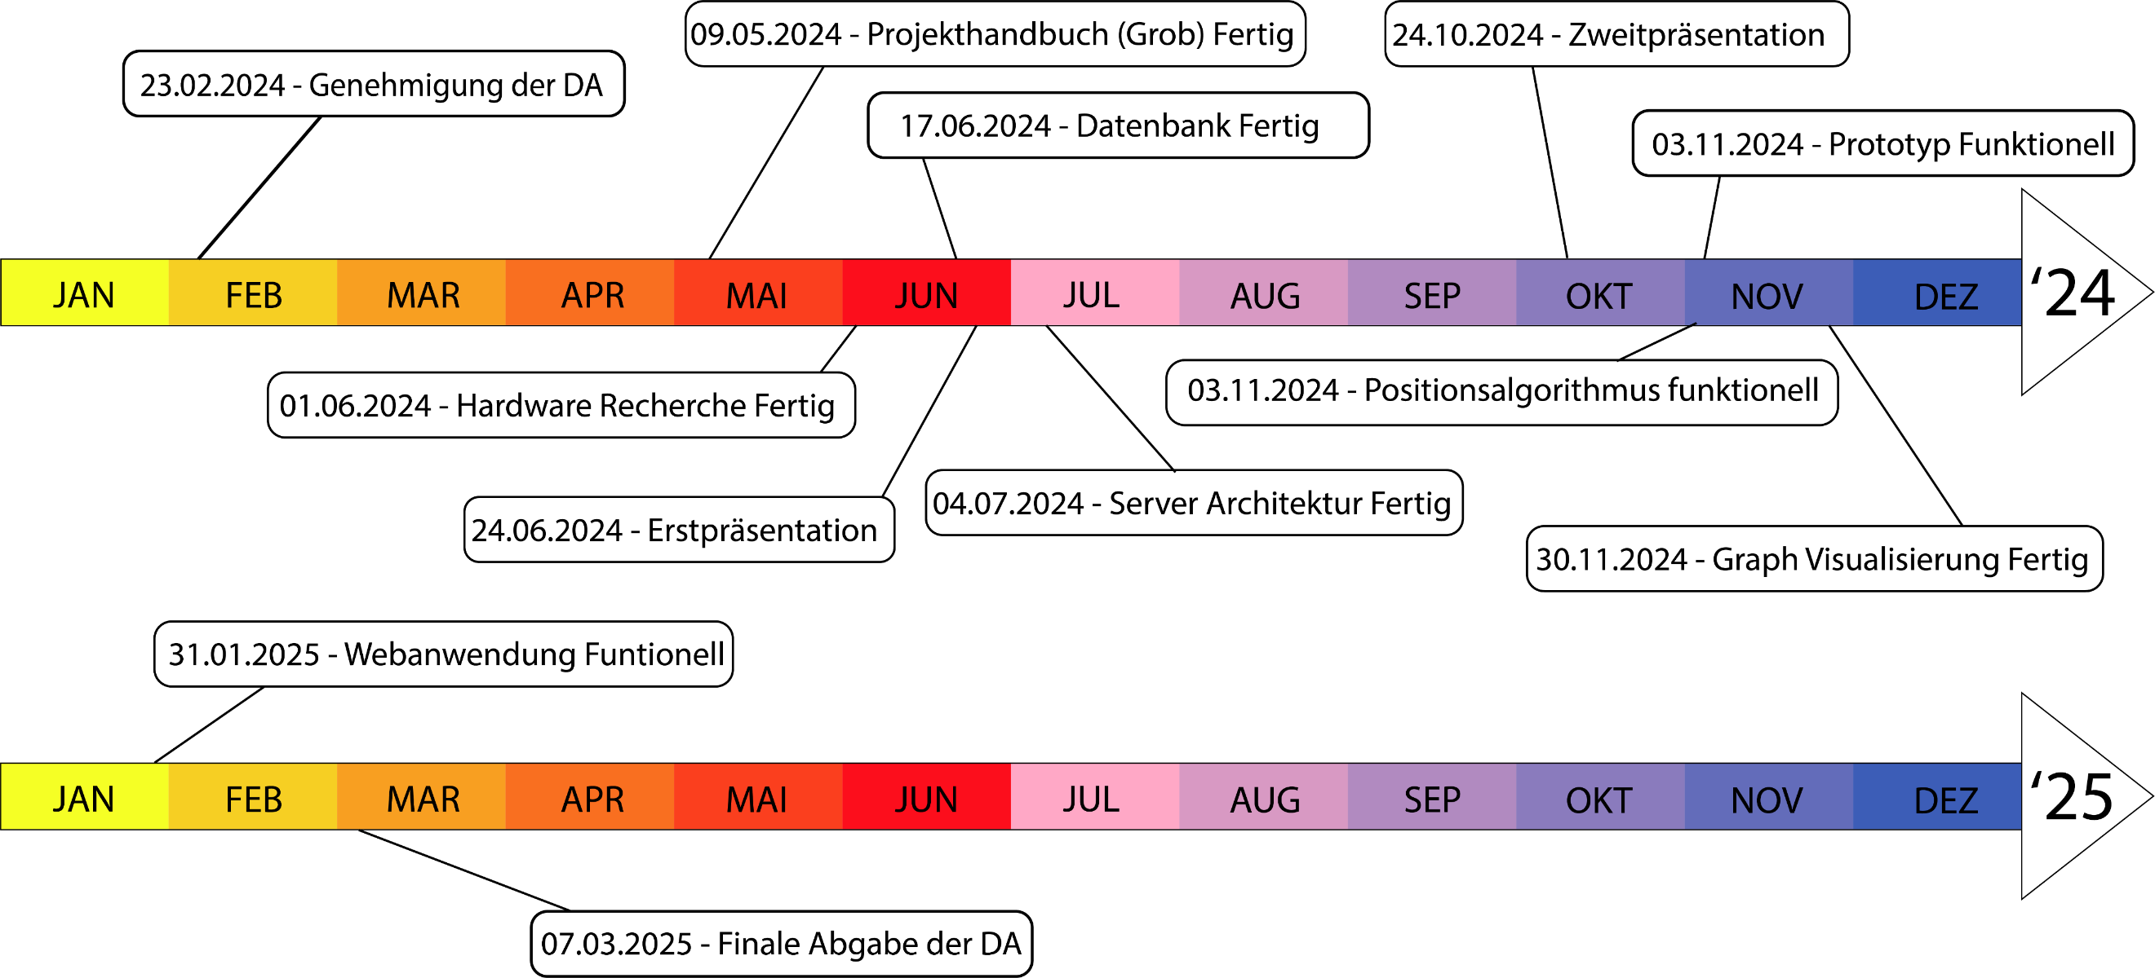
PM – Milestones gantt diagram

Slide 17
PM - Cost estimation
fictitious salary
€ 2.192,25 per person
€ 6.576,75 in total
hardware
€ 60,40 per person
€ 181,19 in total
€ 81,19 for hardware
€ 100 for printing the DT

Slide 18
Literature
REST API Design Rulebook - O’Reilly Media
Elektrische und elektronische Messtechnik – Hanser
Automatisierungstechnik – Europa Lehrmittel
ChatGPT
Data sheets
Esp32, Arduino Nano, Raspberry Zero
BME280
GY-NEO6MV2

Slide 19
Additionals

Slide 20
PM - Milestones
2024-02-23: Approval of the DT
submission of the application by the students
DT documentation has been completed and signed
2024-05-09: Project plan rough draft completed
objectives filled out
project plan filled out
2024-06-01: Hardware component research completed
determination of components
price calculation
schedule calculation

Slide 21
PM - Milestones
2024-06-17: Databases ready
general container information
sensor data
2024-06-24: Initial presentation of the DT
summarise progress
create Gantt chart
2024-07-04: Server architecture ready
server is ready for use
REST interface
access can be granted from anywhere

Slide 22
PM - Milestones
2024-09-04: Prototype functional
hardware components purchased and delivered
soldering the components
data transmission via MQTT
2024-10-23: Second presentation of the DT
summarise progress
2024-11-03: Position algorithm functional
approximate position of the container
determine distance to neighboring containers

Slide 23
PM - Milestones
2024-11-30: (Directed Draggable) Graph Visualisation
visualise container distances to others
movable nodes
2025-01-31: Web application functional
data query possible
attractive GUI
2025-03-07: Final submission of the DT
proofread
all three subtopics completed
DT submitted

Slide 24
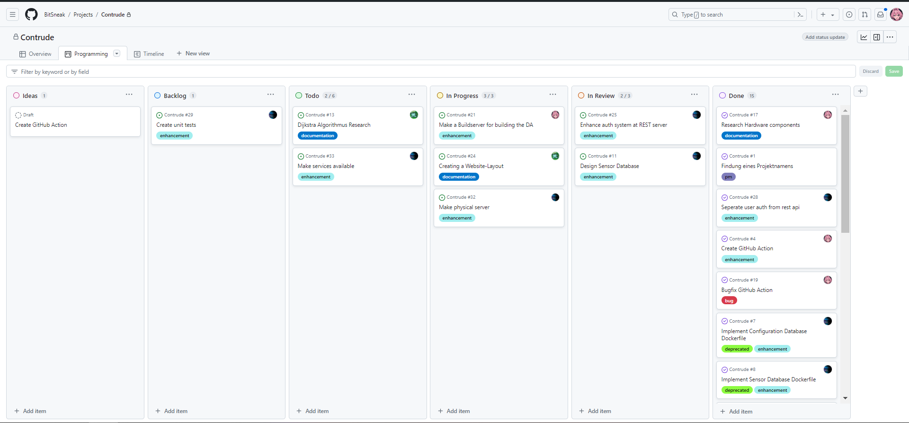
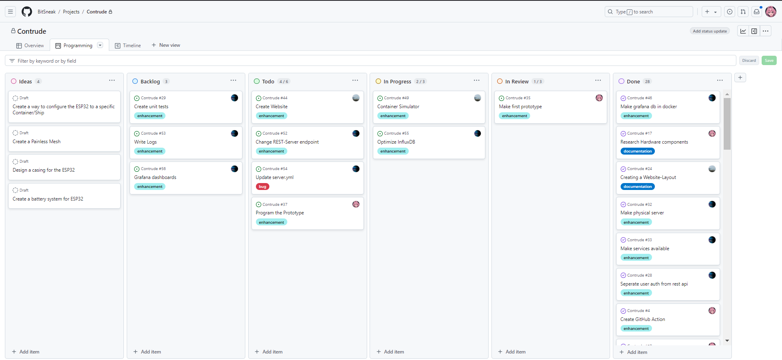
PM – How it is lived

Slide 25
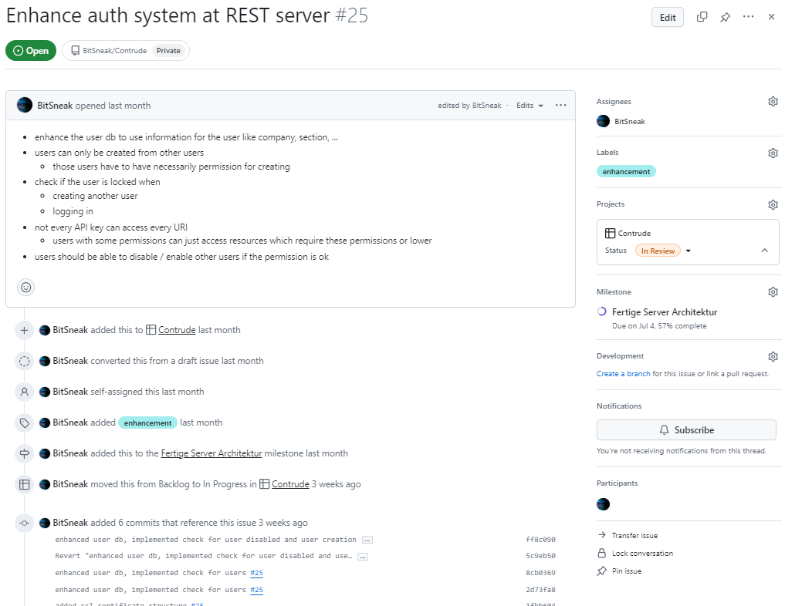
PM – How it is lived

Slide 26
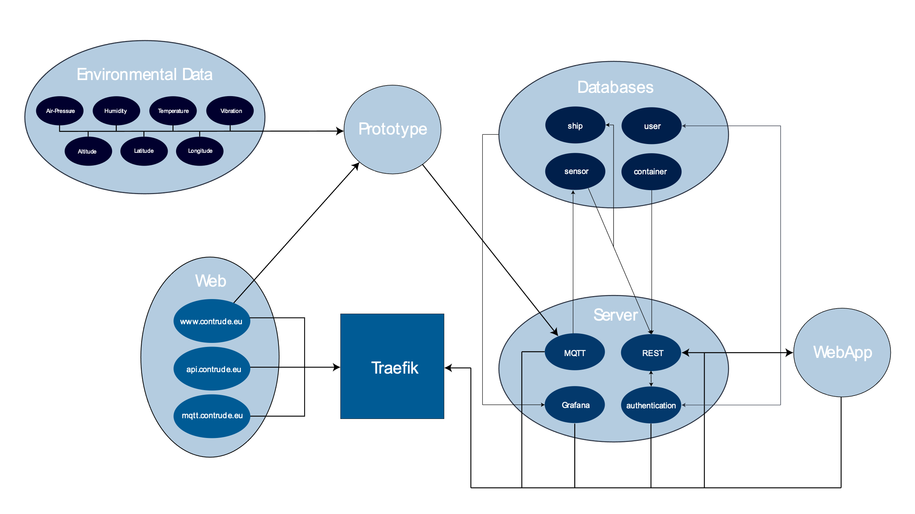
Server structure

